Slide 1

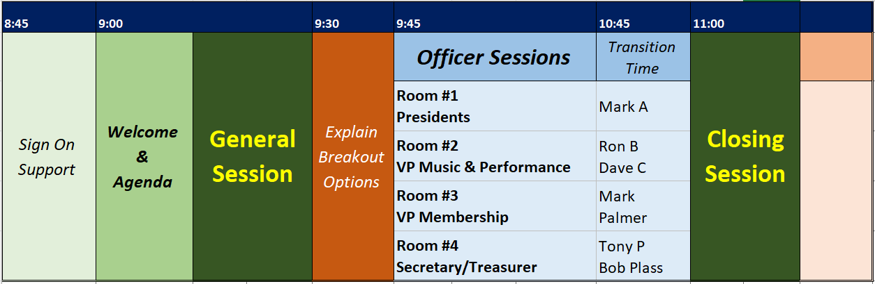
WELCOME!
In the PARTICIPANTS list, please find your name.
Click the […] button on the right side and select RENAME.
Change it to include your FIRST name, LAST name, and chapter. Thanks!!
2025
Leadership
Academy
Notes:
Good Morning Rocky Mountain District!
And welcome to Session 1 of our 2025 Leadership Academy. Many of you will recall our 2024 Session this past January, where we provided a plethora of proliferous options and breakout sessions. As we reviewed the timing of the January sessions and listened to your feedback, we saw the opportunity to provide additional support to NEW chapter officers or chapter officers who were assuming new positions, but January is a little late in the process for them.

Slide 2
WELCOME!
Session 1 – Nov 16
Presidents
VP Music & Perf
VP Membership
Secretary/Treasurer
In the PARTICIPANTS list, please find your name.
Click the […] button on the right side and select RENAME.
Change it to include your FIRST name, LAST name, and chapter. Thanks!!
2025
Leadership
Academy
Notes:
So that’s what today is all about…. We will focus on these 4 core positions in our chapter.
Pres, VP Mus & Perf, VP Membership, and Sec/Treas
I also want to welcome other chapter officers who may be attending today, including VP for Marketing & PR, Board Members at Large, or even chapter members who might not be on the board and serve in other roles within your chapter. Everyone is welcome today, and we hope that you’ll find value in the content presented. When we go into the breakout sessions, feel free to choose any one of the breakouts that suit you. If you’re not sure, I’d recommend that all Section Leaders and Music Team members join the Music VP class, and everyone else can hop into the Membership VP Session.
In addition to our breakouts, we also have the videos….

Slide 3
WELCOME!
Session 1 – Nov 16
Presidents
VP Music & Perf
VP Membership
Secretary/Treasurer
Chapter Presidents Training Class
Chapter Treasurer Training Class
Chapter Secretary Training Class
Marketing & PR Training Class
More Videos from SWD
In the PARTICIPANTS list, please find your name.
Click the […] button on the right side and select RENAME.
Change it to include your FIRST name, LAST name, and chapter. Thanks!!
2025
Leadership
Academy
Notes:
Everyone received the links for these videos in the email invitations this week. We won’t be reviewing these videos today, but if you haven’t had a chance to review these just yet, I’d strongly encourage you to go back when you have time and review this content. Even if you’ve been in position for a while, there is great value in this training. These links will also be posted to our Leadership Academy page on RMDSING.
And finally…

Slide 4
WELCOME!
Session 1 – Nov 16
Presidents
VP Music & Perf
VP Membership
Secretary/Treasurer
In the PARTICIPANTS list, please find your name.
Click the […] button on the right side and select RENAME.
Change it to include your FIRST name, LAST name, and chapter. Thanks!!
2025
Leadership
Academy
Notes:
And finally… I want to make sure everyone marks Jan 18th on your calendar for Session 2 of RMD Leadership Academy.

Slide 5
WELCOME!
Session 1 – Nov 16
Presidents
VP Music & Perf
VP Membership
Secretary/Treasurer
Session 2 – Jan 18
HOD Meeting
VP Marketing/PR Social Media
Breakout Sessions
Youth in Harmony, Show Production, Grant Writing,
Recruitment & Retention, and much more!
In the PARTICIPANTS list, please find your name.
Click the […] button on the right side and select RENAME.
Change it to include your FIRST name, LAST name, and chapter. Thanks!!
2025
Leadership
Academy
Notes:
This meeting will include an HOD Meeting which Tony and Mark leaders will discuss today. We are also planning on adding a Marketing Session there. But the main content for January will be the Breakout Sessions, where we leverage the talents and skills of the Rocky Mountain District to bring you resources and training to improve the member experience within your chapter. Save the Date, and if you have ANY REQUESTS for breakout sessions or topics, please reply back to one of the emails you received from me this week and let me know.
Before we dive in with today’s content, I’d like to provide a couple reminders and some general housekeeping items.

Slide 6
Today’s Schedule
Notes:
#1 – PLEASE MUTE yourself unless you are speaking… We do have a setting here that will MUTE everyone, but we really don’t want to FORCE that setting, because today is about discussion and conversation. We WANT you to ask questions, and SHARE what’s going on in your chapter. And if we force that setting we lose that option for meaningful dialog. So.. Please please please keep yourself MUTED.
And just a reminder that today’s sessions are all being recorded to help benefit those members who were not able to join us live today.

Slide 7
Today’s Schedule
In the PARTICIPANTS list, please find your name.
Click the […] button on the right side and select RENAME.
Change it to include your FIRST name, LAST name, and chapter. Thanks!!
Notes:
#2 – If you haven’t already done so, please RENAME yourself in the PARTICIPANTS list. This was displayed at the start of our call so many of you have already done so. But renaming yourself really helps in the breakout sessions. So please do that now…. First name, Last name, Chapter name.
#3 – RAISE YOUR HAND…. If there is a conversation going on Zoom, it’s very difficult to just know when to interrupt if you have to say something. So we’re going to try this right now… I want everyone to Raise your Hand…. That’s great…. Once you get called on, click that again to LOWER your hand…
#4 – and finally, CAMERAS ON… Unless it really doesn’t work for you, we’d like to request cameras on for today’s academy.
Okay, I’m going to turn it over to our RMD leadership, please welcome your RMD President, Tony Sparks!

Slide 8
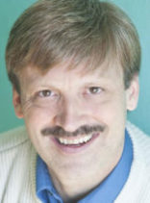
Tony Sparks
President
Rocky Mountain District
2025
Leadership
Academy

Slide 9
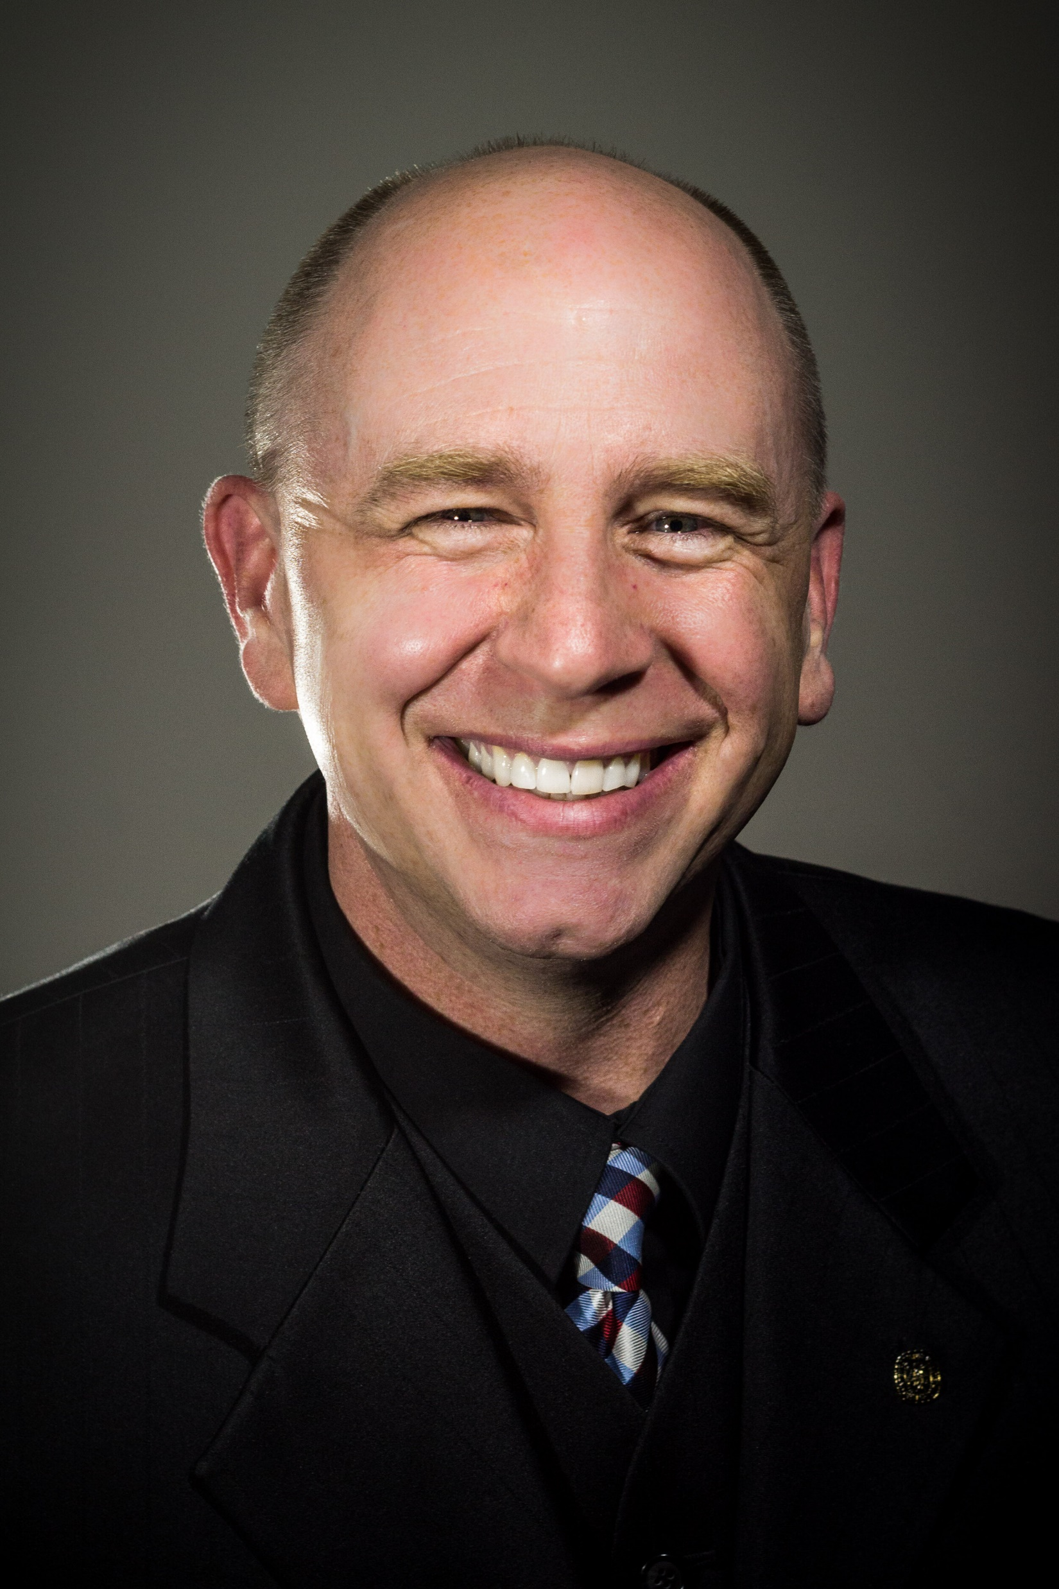
Jim Clark
Director of Development
Harmony Foundation
jclark@harmonyfoundation.org
2025
Leadership
Academy

Slide 10
Today’s Schedule
Notes:
Okay we are ready to move on to our Officer Sessions. Each of you will have the option to choose which breakout room you attend. If you put your mouse on the screen over on the left you should see a grid with 4 dots that says BREAKOUT ROOMS… just click on that grid and make your selection.
If for some reason you need to change rooms, click the LEAVE button upper right and leave your breakout. You’ll return to the main session here and be able to select a different breakout session.

Slide 11

Questions and
Open Discussion
2025
Leadership
Academy

Slide 12
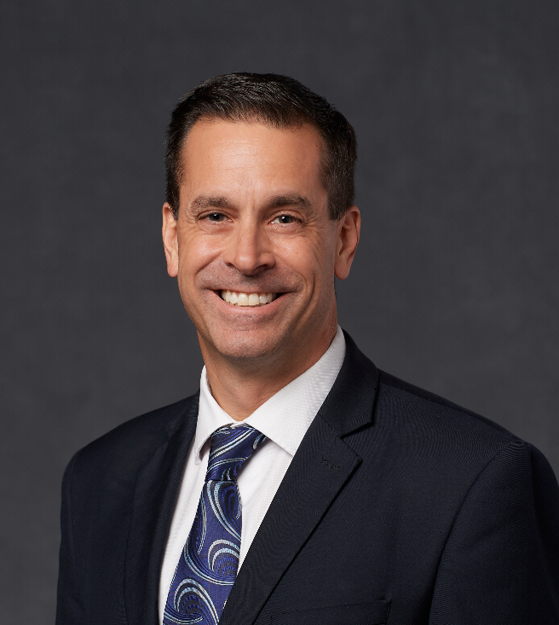
Mark Andromidas
Executive Vice-President
President Elect 2025-2026
Rocky Mountain District
2025
Leadership
Academy

Slide 13
Topic #1: Successes
Looking back at 2024, what are some successes in your chapter or chorus?
  What was involved in creating that success?
  If you repeated this event or program, what might you change?
2025
Leadership
Academy

Slide 14
Topic #2: Challenges
Looking back at 2024, what are some challenges you faced in your chapter?
  What steps did you take to overcome them?
  Is this still a challenge today?
2025
Leadership
Academy

Slide 15
Topic #3: Resources
In consideration of the challenges facing our chapters today, what are some ways that your RMD Leadership Team can provide solutions or support?
2025
Leadership
Academy

Slide 16
Topic #4: New Concepts
Do you have any creative new ideas or anything else to suggest to our RMD Leadership?
  There are no bad ideas!!!
2025
Leadership
Academy

Slide 17
THANK YOU!
2025
Leadership
Academy

Slide 18
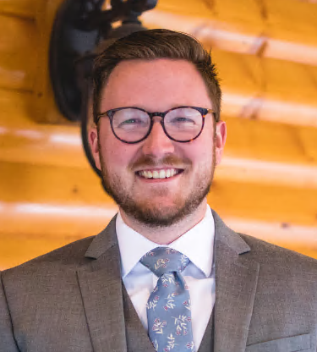
Dan Rohovit
Singing Community Program Mgr
Barbershop Harmony Society
2024
Leadership
Academy

