Slide 1

Room #3 Show Production Building Your Audience
Bruce Sellnow
VP Chapter Support &
Leadership Training
Rocky Mountain District
2025
Leadership
Academy

Slide 2
Enhancing Your Show Production
Define “Success…”
Why are you here?
What do you want to learn today?
Notes:
Spend time capturing desires and requests of the students

Slide 3
Enhancing Your Show Production
Define “Enhanced…”
An entertaining and enjoyable experience for your audience that will instill in them a feeling of
“Can’t wait for the next one!”
for all your future shows…
Notes:
Define ENHANCED - What’s the OBJECTIVE?
.BUILD Your AUDIENCE
.If you build your AUDIENCE, everything else will happen....

Slide 4
Enhancing Your Show Production
Priorities – Decision Logic
Audience Enjoys The Show
Audience Enjoys The Show
Fill Every Seat (regardless of price)
Build Show Reputation in Community
Build Relationships w/Local Groups
Chorus Members fulfilled
Make a profit

Slide 5
Enhancing Your Show Production
Audience Sources
Advertising, Show Flyers, Newspaper Ads, Radio Spots, Facebook, Instagram, Periscope, Twitter, your wife’s quilting group, etc., etc.
MEMBERS
Notes:
] Audience SOURCES
.[S8] MEMBERS have to BELIEVE in the show...
.INVEST in your Show - What’s that look like?
.An EMPTY seat costs $0.00 to fill....

Slide 6
Enhancing Your Show Production
Audience Sources
MEMBERS
Advertising, Show Flyers, Newspaper Ads, Radio Spots, Facebook, Instagram, Periscope, Twitter, your wife’s quilting group, etc., etc.
Notes:
] Audience SOURCES
.[S8] MEMBERS have to BELIEVE in the show...
.INVEST in your Show - What’s that look like?
.An EMPTY seat costs $0.00 to fill....

Slide 7
Enhancing Your Show Production
Basic Show Budgets
Venue $1,800
Talent $ 400
Other $ 800
---------
Total $3,000
Tickets
@ $15 = 200
$1,800
$ 800
$ 800
---------
$3,400
227
$1,800
$1,600
$ 800
---------
$4,200
280
$1,800
$3,000
$ 800
---------
$5,600
373
$20 = 150 170 210 280
Notes:
[S9] Basic Show Budgets
.How many tickets to get Masterpiece on your show?
.What if you chose to INVEST?
.[S10] GVC Results

Slide 8
Enhancing Your Show Production
GVC Show Numbers
YEAR
Attendance
Income
Expense
Net Profit
2012
385
$7,685
$5,774
$1,911
2013
450
$7,983
$4,228
$3,755
2014
472
$8,349
$5,635
$2,714
2015
603
$8,714
$4,920
$3,794
2016
451
$8,122
$4,403
$3,719
2017
587
$8,704
$6,061
$2,643

Slide 9
Enhancing Your Show Production
Key Elements to Great Shows
Great Talent
Great Team
Great Script
Great Pacing – The Fantastic Four
Great Flow – Peaks and Valleys
Notes:
.

Slide 10
Enhancing Your Show Production
Great Talent
Headliner: RMD Champ or greater
You might need to build up to that level

Slide 11
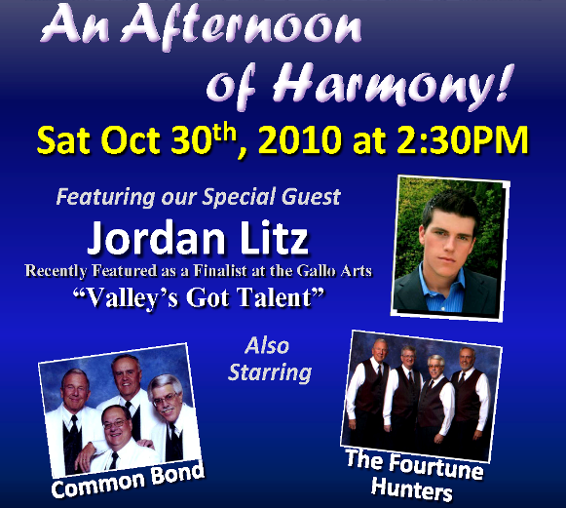
Enhancing Your Show Production
Notes:
NOTE: In those two chapter quartets… three of them are the same guys… just a different LEAD!

Slide 12
Enhancing Your Show Production
Great Talent
Headliner: RMD Champ or greater
You might need to build up to that level
Additional Show Talent
Local HS Groups of renown
Provide Creative Incentives
Local SAI Choruses or Mixed Choruses
Opportunity for 8-part arrangements

Slide 13
Enhancing Your Show Production
Chapter Quartets
Lots of Show Opportunities Annually
Dinner Shows or Cabarets
Christmas Caroling (Malls, etc…)
Quartet Gigs / Requests
Other Chapter Shows & Singouts
Annual Show Requirement
District Qualified: (2-3 Song Set)
Non District: (1 song walkout from Chorus)
This also applies to SAI Guest Quartets

Slide 14
Enhancing Your Show Production
Great Team
Show Chairman
Energetic Go-Getter; willing to do anything
Show Committee
Tickets, Advertising, Sets & Props
Stage Manager
Non-Performing Team Member
Calls the shots – works with House Crew

Slide 15
Enhancing Your Show Production
Great Script
We are SINGERS, not actors!
Write your script accordingly…
Minimize dialog from chorus members
Engage inactive members if qualified
Use Voiceovers at several points during show
Use a storyline around your contest package
Find a great MC or hire one
Make sure your script supports Great Pacing
Notes:
VOICEOVER: Give me your tired, your poor,
Your huddled masses yearning to breathe free,
The wretched refuse of your teeming shore.
Send these, the homeless, tempest-tossed to me,
I lift my lamp beside the golden door!

Slide 16
Enhancing Your Show Production
Great Pacing
Uncle Lloyd’s Standing “O” still works!
Opener (uptune)
Easy Beat
Ballad
Novelty
Closer – Big Tag!
Always have at least 1 of the Fantastic 4
Singing – Talking – Laughter – Applause

Slide 17
Enhancing Your Show Production
Fantastic Four
Singing, Talking, Laughter, or Applause
Include humor by the MC, but not “jokes”
Write your script to accommodate:
Moving chorus on/off risers
Changing Set or Scenery
Quartet costume changes
No noise on stage during Quartet Sets

Slide 18
Enhancing Your Show Production
Great Flow
Your Chorus starts and ends the show
Chorus Set 1
Guest Act 1
Guest Act II
** Intermission **
Headliner
Chorus SET 2
Finale
End both Act 1 & 2 in a big way

Slide 19
Enhancing Your Show Production
http://production.longspeakchorus.net
Stuff you’ll find there…
This Powerpoint
GVC & VoCal Tech Scripts
GVC & VoCal Production Schedules
Show Day Sign Sets
Sample Show Flyers
(Content in Native Mode and also PDF)

Slide 20
Enhancing Your Show Production
How Do We Get Started?
Plan 12-18 months ahead
Secure Venue, Date, Talent
Signed Contracts
Choose Show Theme and Songs
Create Complete Show Flow
Choose a Great Finale!
Market “Save the Date” and promote

Slide 21
Enhancing Your Show Production
How Do We Keep Going?
6 Months Ahead
Finalize Song List and Create Show Timeline

Slide 22
Enhancing Your Show Production

Slide 23
Enhancing Your Show Production

Slide 24
Enhancing Your Show Production
How Do We Keep Going?
6 Months Ahead
Finalize Song List and Create Show Timeline
Confirm Tech Crew
Sound, Light, STAGE MANAGER
Online Ticket Sales (BPT)
Show Flyer & Website
Appoint Afterglow Chairperson

Slide 25
Enhancing Your Show Production
How Do We Keep Going?
3 Months Ahead
Script Finalized
All Songs Introduced
2 Months Ahead
Create Tech Script

Slide 26
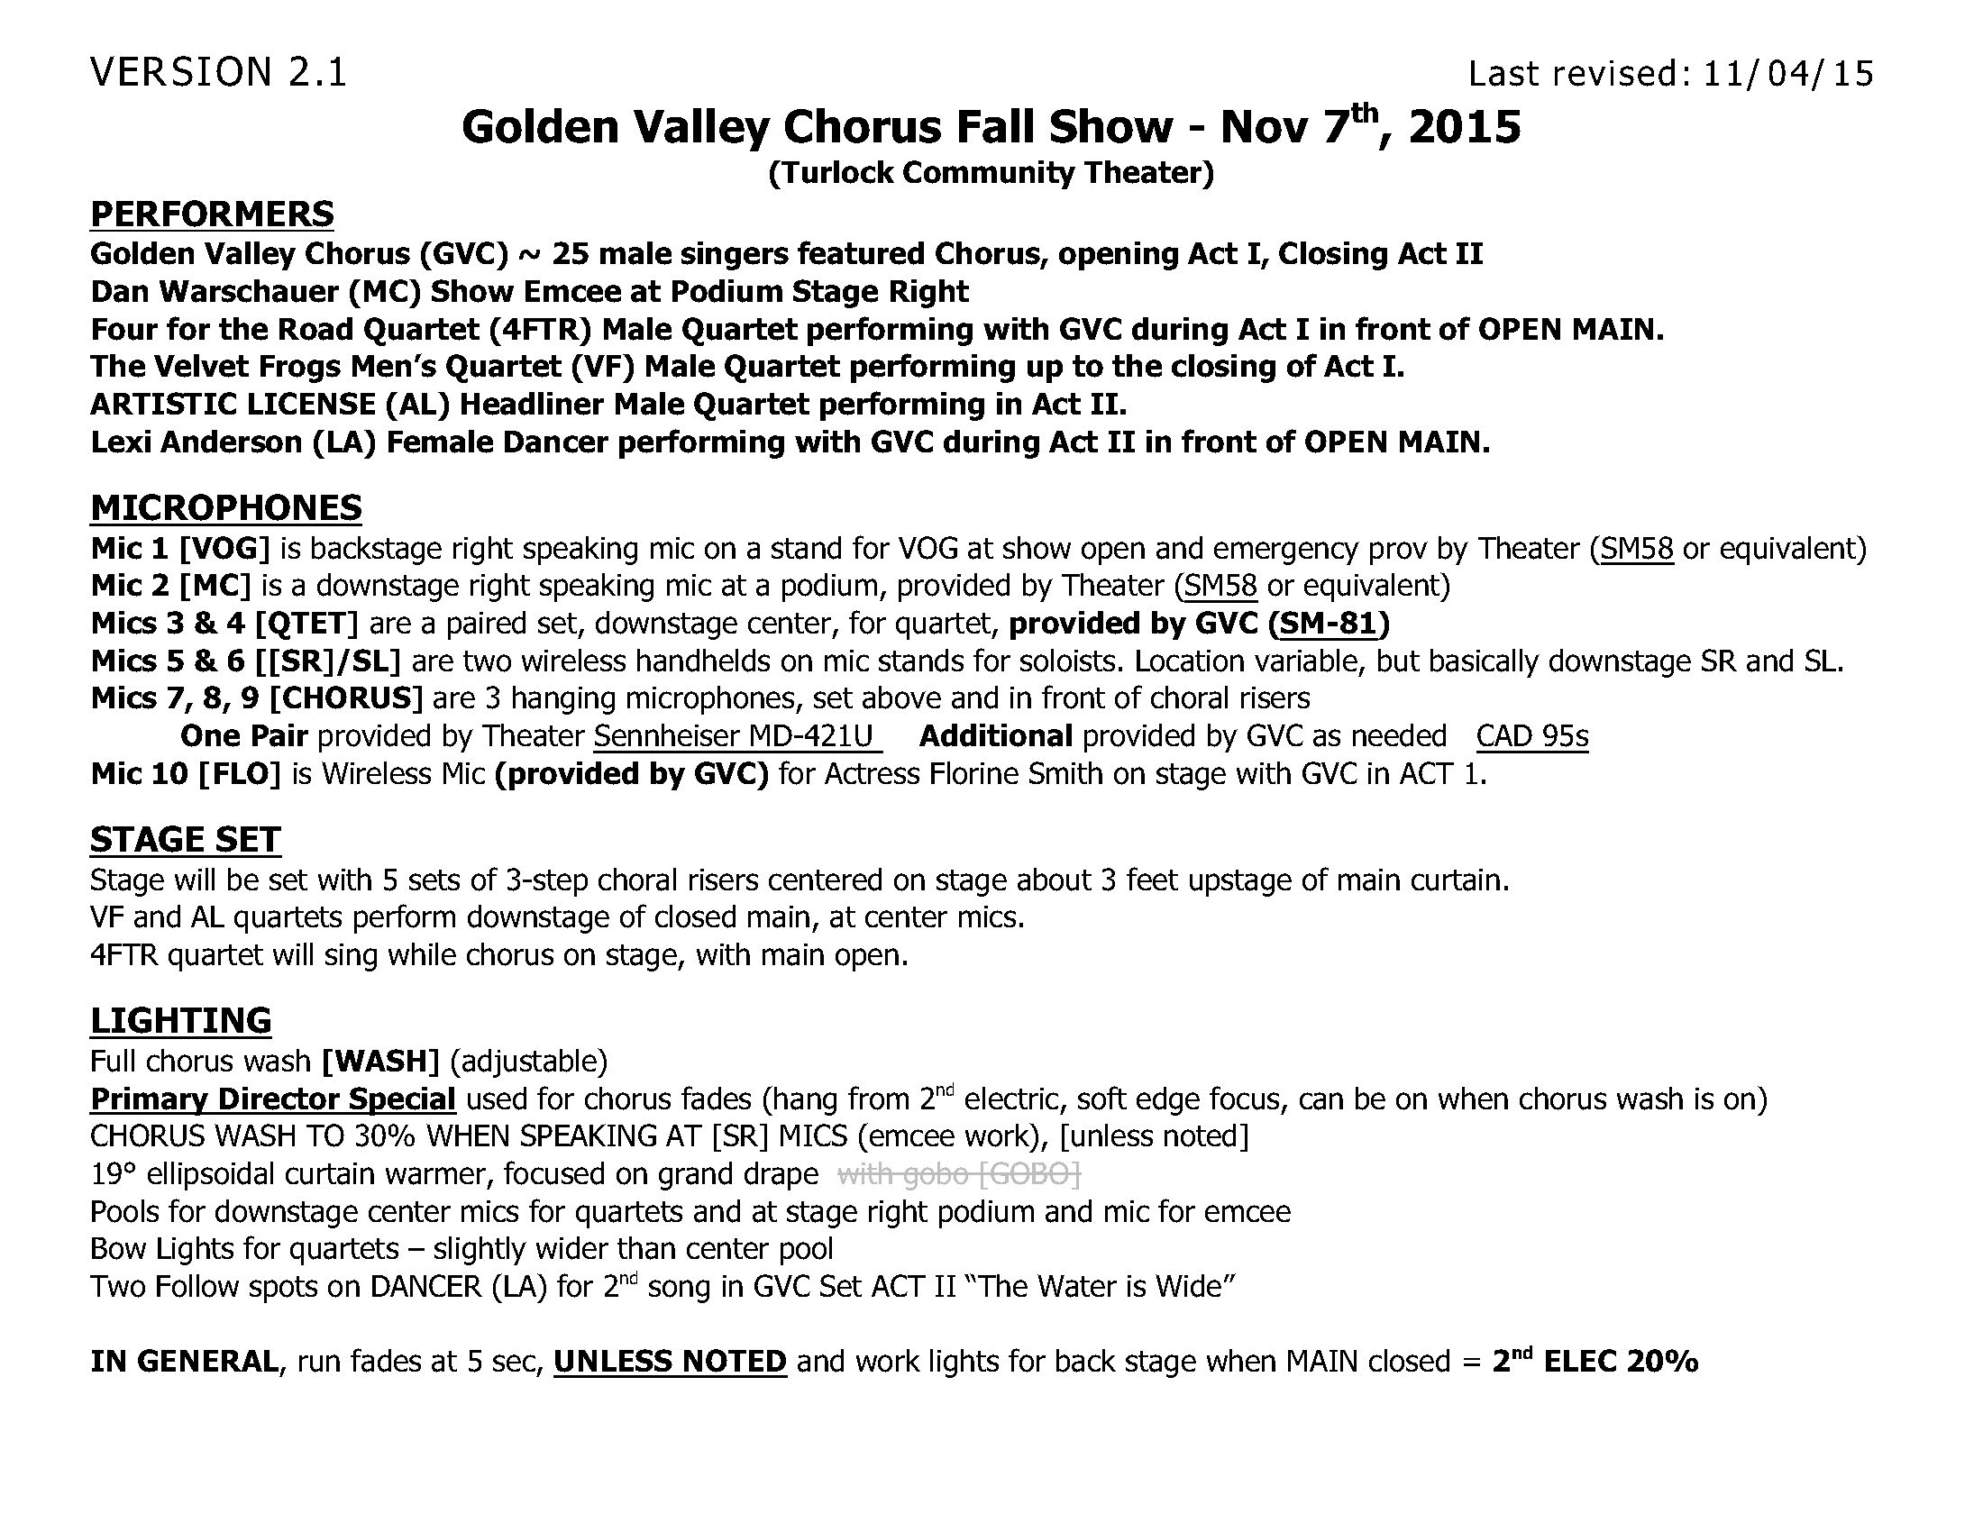

Slide 27
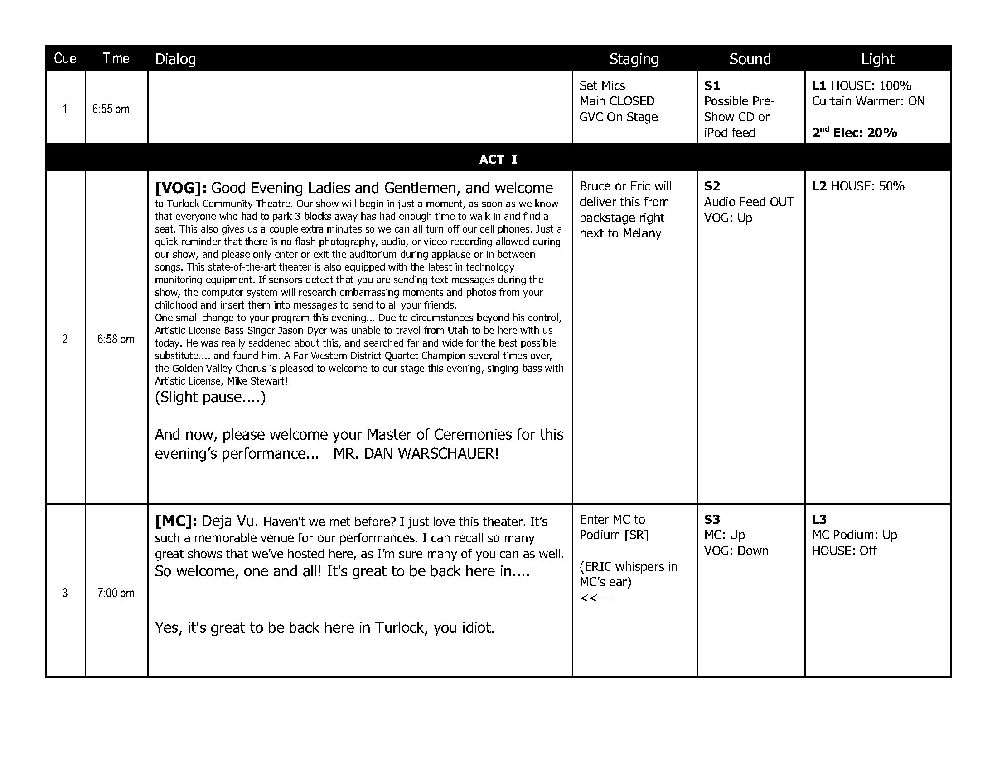

Slide 28
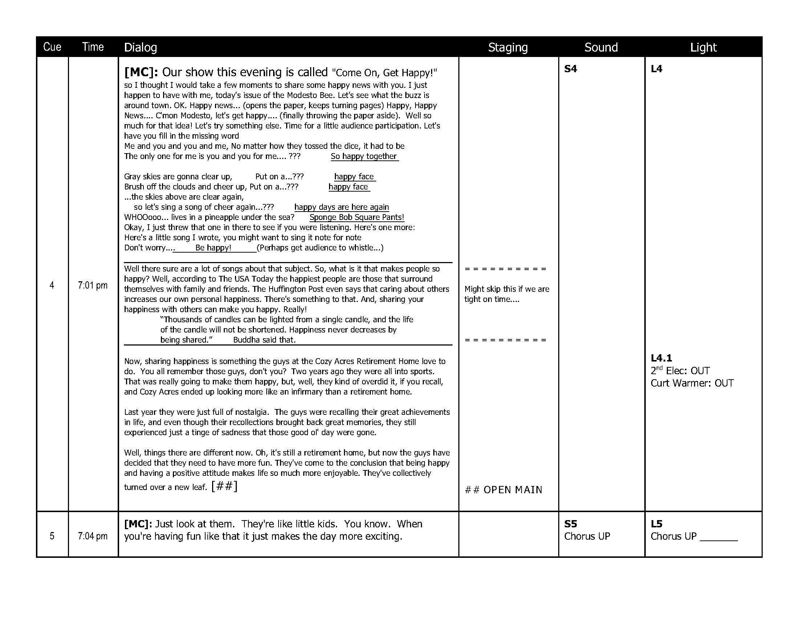

Slide 29
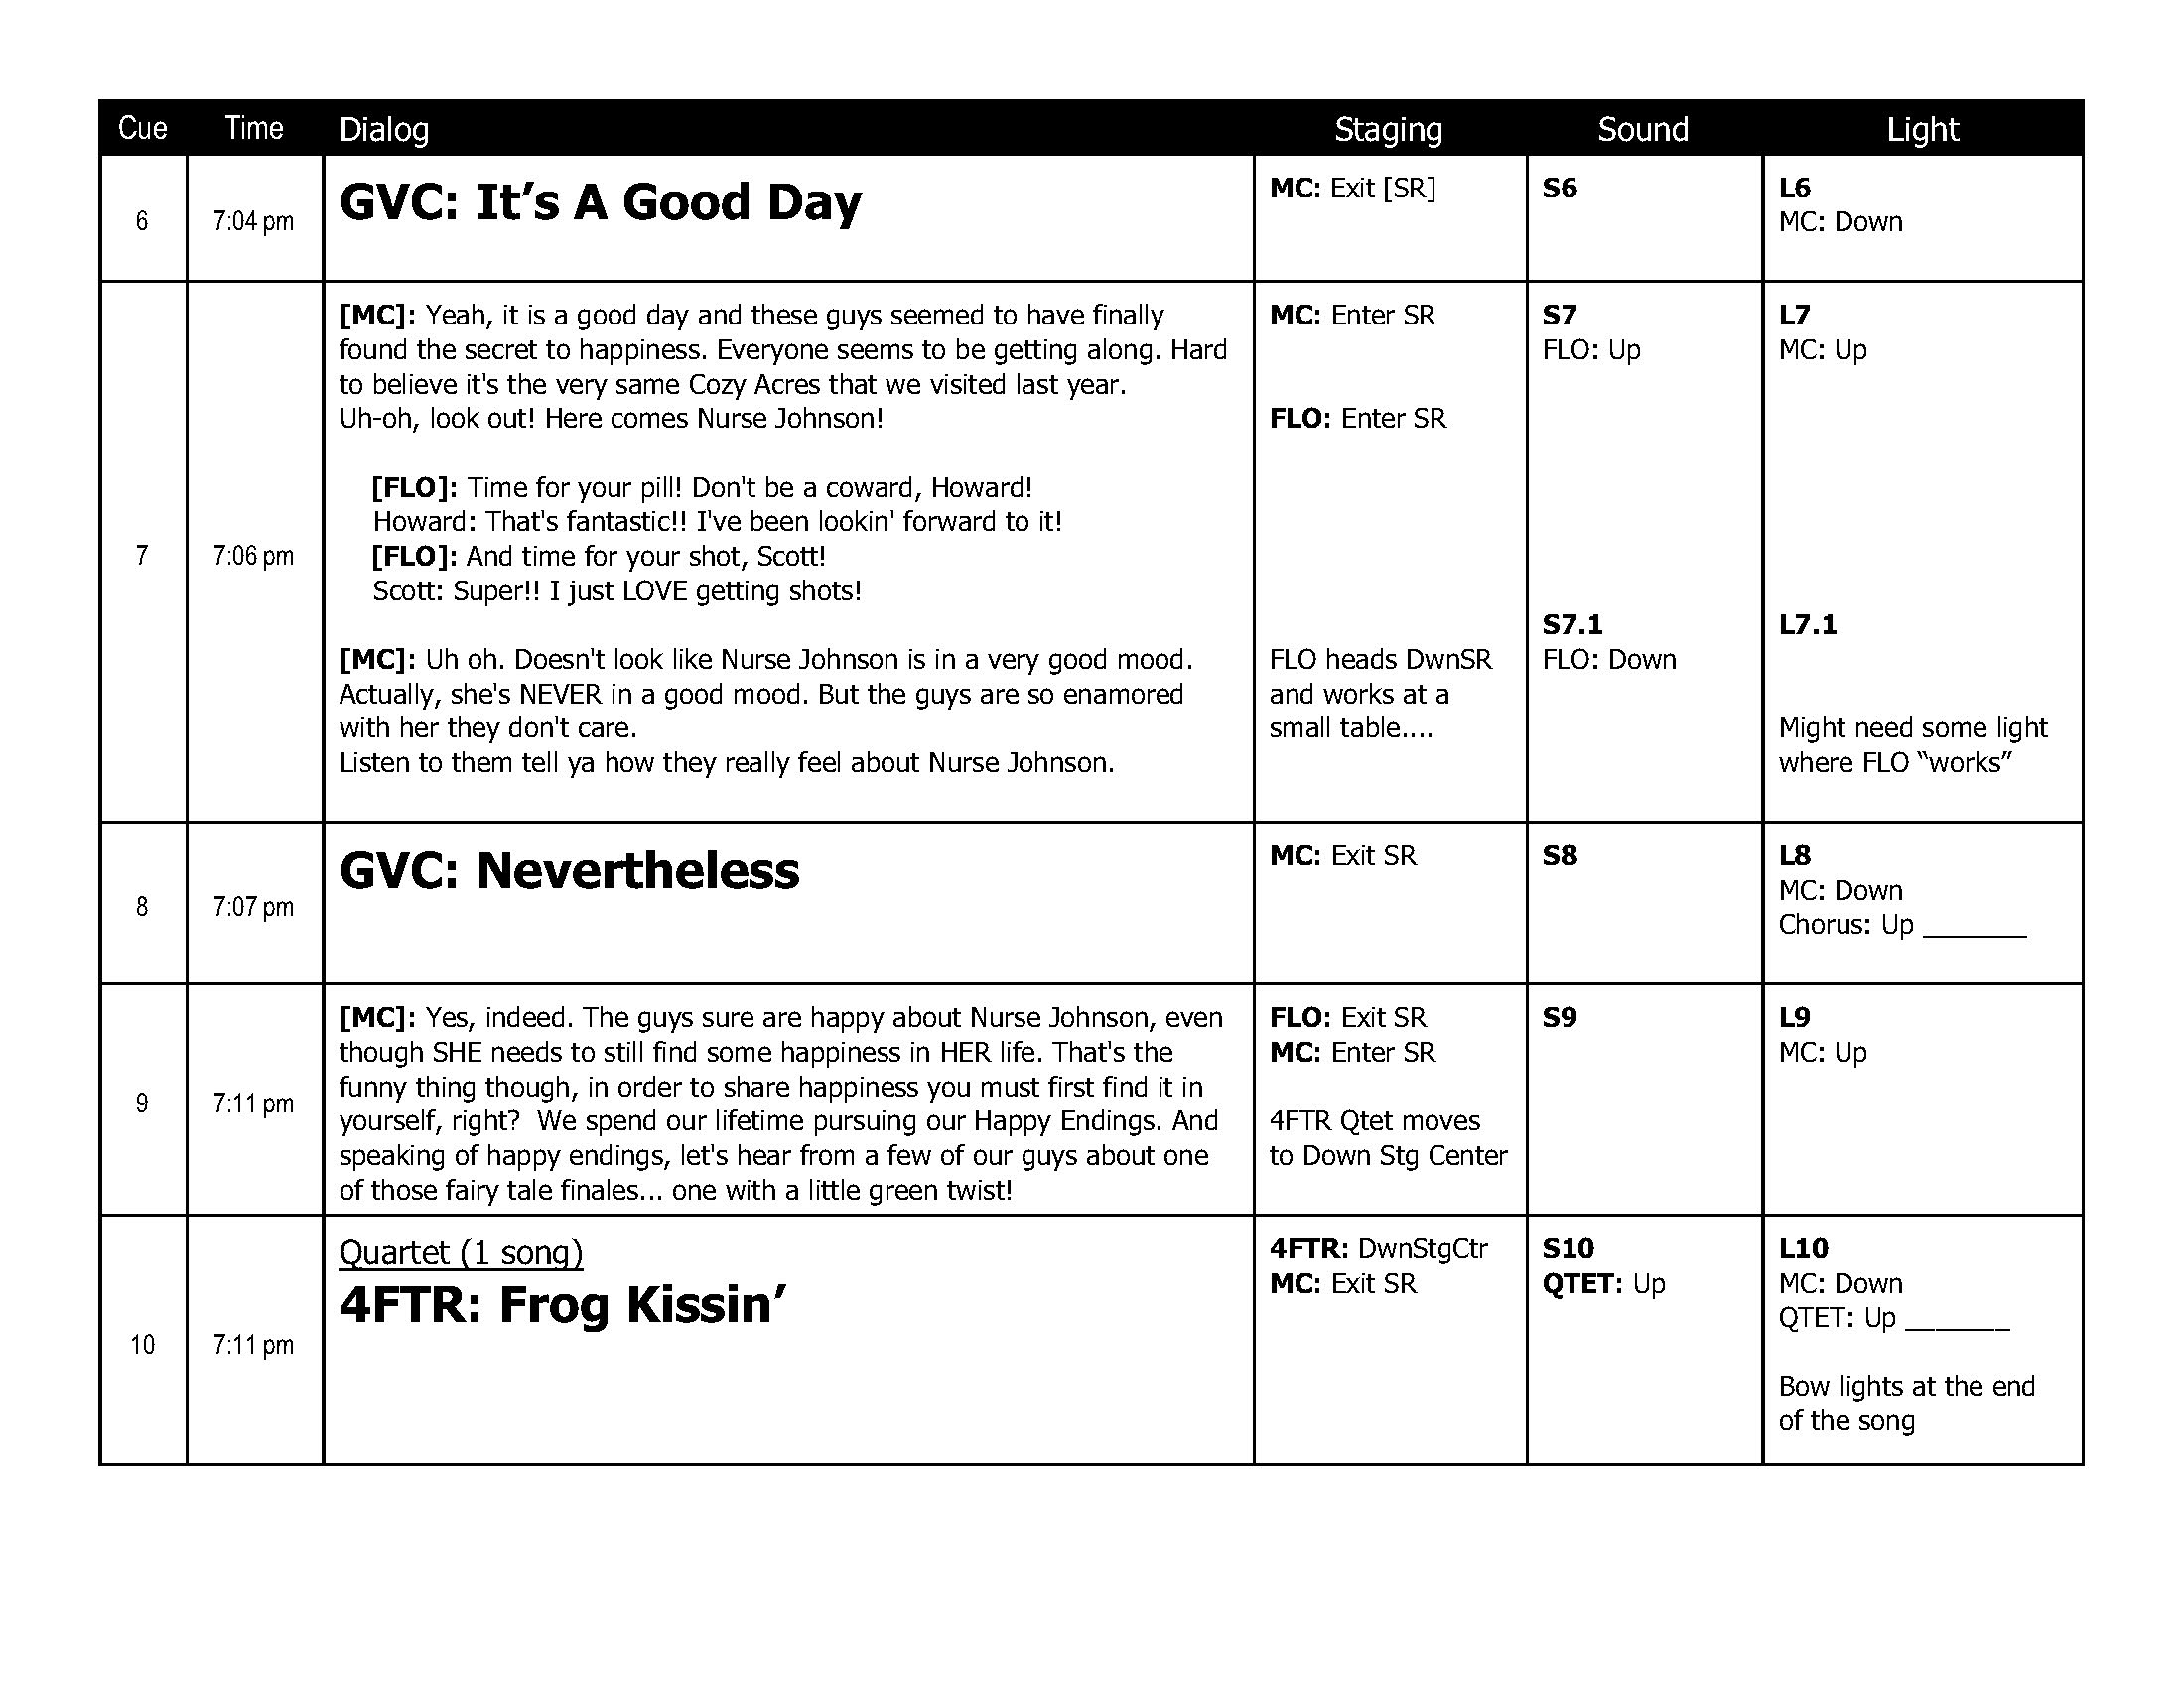

Slide 30
Enhancing Your Show Production
How Do We Keep Going?
3 Months Ahead
Script Finalized
All Songs Introduced
2 Months Ahead
Create Tech Script
Create Show Day Schedule

Slide 31
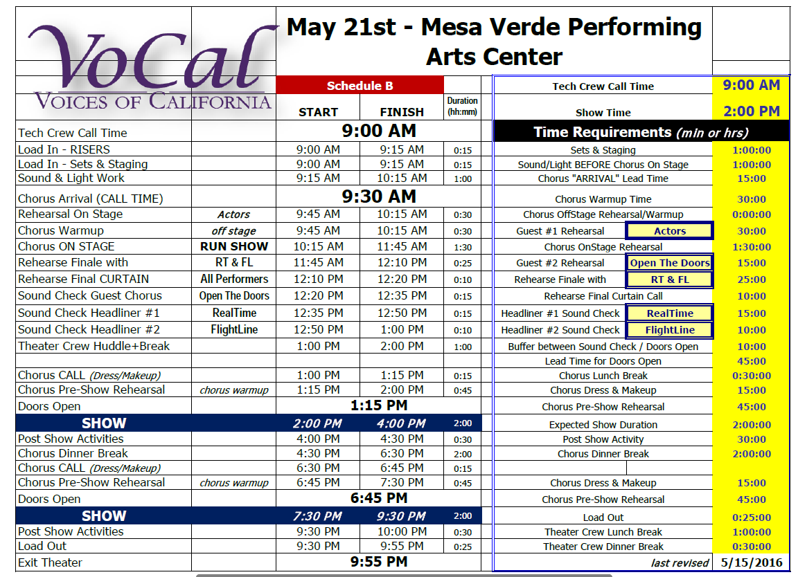

Slide 32
Enhancing Your Show Production
How Do We Keep Going?
3 Months Ahead
Script Finalized
All Songs Introduced
2 Months Ahead
Create Tech Script
Create Show Day Schedule
Quartet Host Contact

Slide 33
Enhancing Your Show Production
It’s SHOWTIME!
Prepping The Stage
Mics, Lights, Riser Positioning, Sets & Props
Chorus Call
Warmup offstage
Blocking, Tech Rehearsal
Finale Rehearsal w/Headliner
Quartet Sound Checks

Slide 34
Enhancing Your Show Production
Curtain UP!
Items to consider during the show
No Chorus Members visible during show
Absolute Quiet on stage
Use Costume Changes to add variety
“Chorus Huddle” during intermission to prep for second half performance.

Slide 35
Enhancing Your Show Production
That’s a Wrap!
Items to consider after the show
Audience Meet & Greet
Pre-Assign areas for cleanup responsibilities
Get Headliner to Afterglow

Slide 36
Enhancing Your Show Production
Questions / Comments
Q & A

Slide 37
Enhancing Your Show Production
And Another Thing…
Lobby setup & Audience Info Capture
Concessions
The Art of Gold Medal Quartet Hosting
Great Afterglows
Your Chapter Success Stories

